Slide 1
Python Library To Transform Image Datasets to Query-able SQL Tables
Class: CSCI 6917/6918
Supervisors: Dr. Kaisler & Dr. Hasanov
Student: Elshan Naghizade
Date: July 3, 2023
1

Slide 2
Project Statement
Problem: Conventional Pytorch/Tensorflow dataloaders use unindexed/sequential CRUD operations.
Solution: Delegating data manipulation of Image Datasets to Relational Databases (SQL)
Rationalizing the objective:
Search/Fetch/Update operations get blazingly fast thanks to the internal optimizations that SQL databases have. (indexing, hashing, etc.)
Using simpler SQL queries to preprocess datasets as opposed to Python coding.
2

Slide 3
Users’ Perspective
Computer Vision engineers spend a significant amount of time to cleanse and transform their image datasets into a state suitable for the model to be developed. Having simple SQL queries to snap through the datasets simplifies the automation of data-preprocessing requiring less manual interventions into the dataset itself, while interacting with the databases themselves.
____________________________________________________________________
RGB BLOB files and their features from image datasets can be automatically extracted and transformed into a structured form with this library. The use of conventional SQL queries on these database tables is most precious utility, dramatically reducing the time previously spent on developing case-specific dataloaders. Above all, the flexibility and speed of SQL have been effectively harnessed.
3

Slide 4
Library Workflow
Image Dataset (Zip/Rar/Folder) Path Detection
↓
Subforlder Traversal
↓
Image to Numpy transformation
↓
Feature Extraction
↓
Numpy to BLOB transformation
↓
Database Entry Stage
4

Slide 5
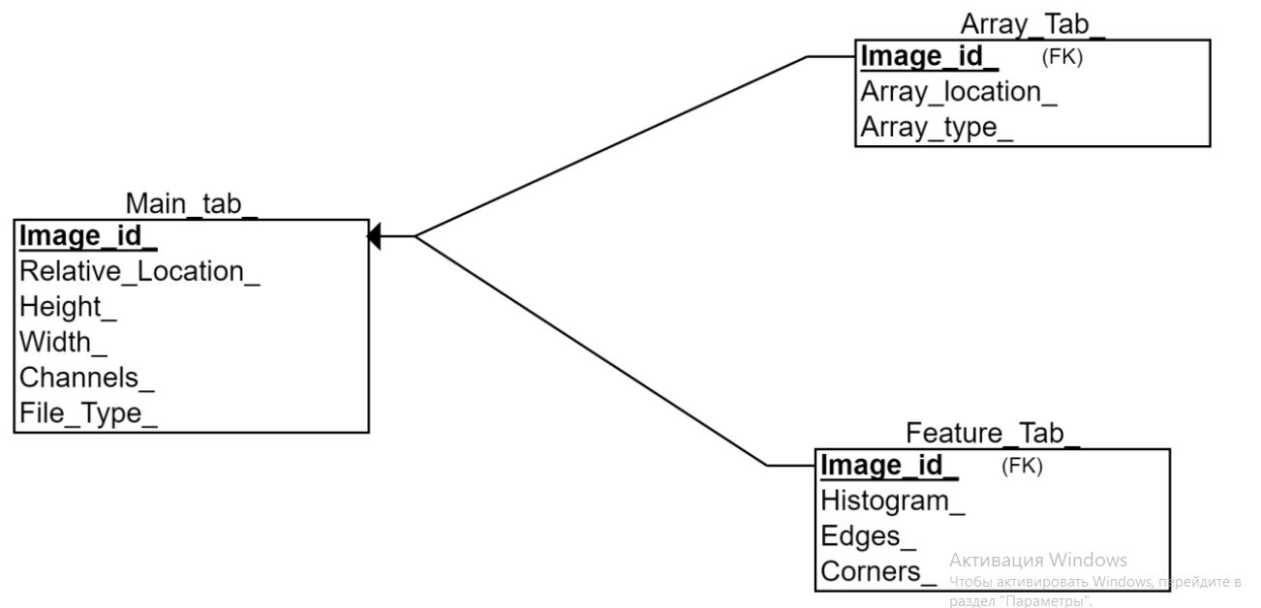
Database Schema
Limitations of BLOB storage
MySQL: The maximum size of a BLOB in MySQL is 4GB.
PostgreSQL: The maximum size is 4TB.
Oracle: It can handle a BLOB of up to 128TB.
SQLite: It can handle a BLOB of up to 2GB
4NF Structure
Images, and Features are uncompressed Numpy arrays.
Location stands for BLOB storage
Generated keys were deemed more suitable since they are to be used as Foreign Keys
BLOB in-Ram Conversion Rate
8,000,000,000 bytes / 3 bytes/pixel = approximately 2.7 billion pixels
5

Slide 6
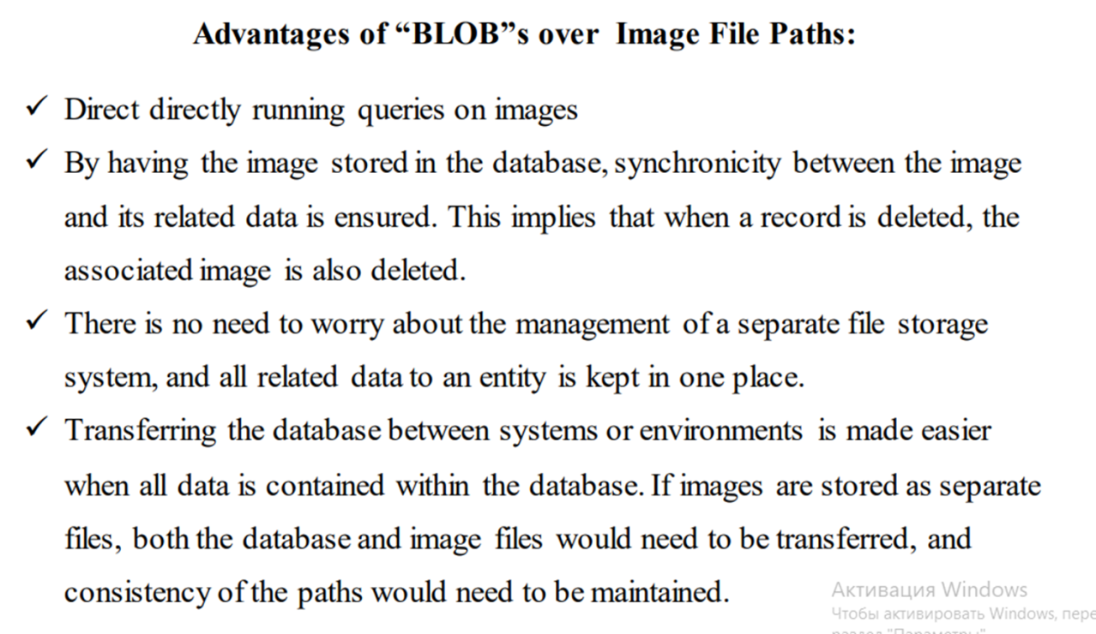
SQL Transformation
Lite version - Generation of SQL statements as texts and storing them as .sql files.
Full version – Using psycopg2 and sqlite3 to directly operate on database systems.
CAVEATS
The image array representation is uncompressed.
Therefore, having a compressed image stored in conventional image formats (e.g., in JPEG format), then converting it to an image array (e.g., a numpy array in Python) could significantly increase the memory requirements since the image data will be uncompressed in this representation. However, being able to directly operate on pixel values is a must for most Computer Vision applications.
6

Slide 7
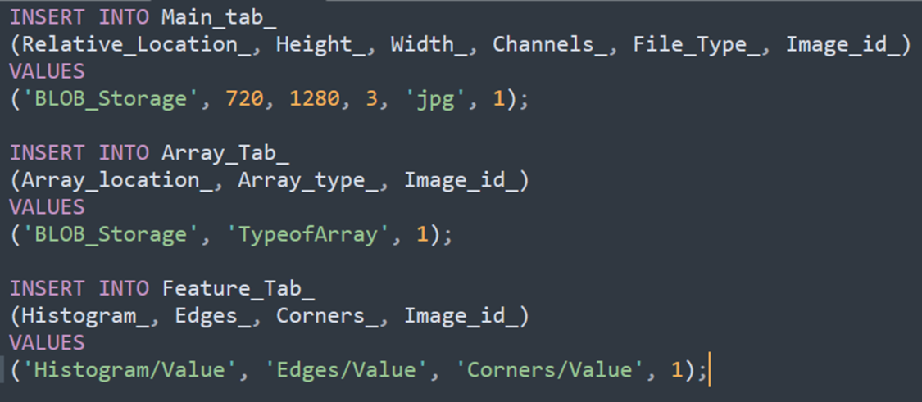

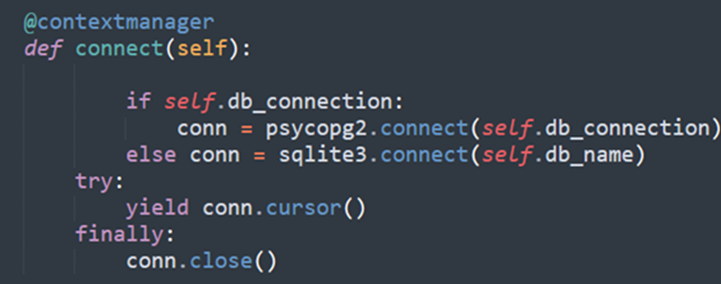
Lite Database Entry:
Automatically Generated Insert Statements
7

Slide 8
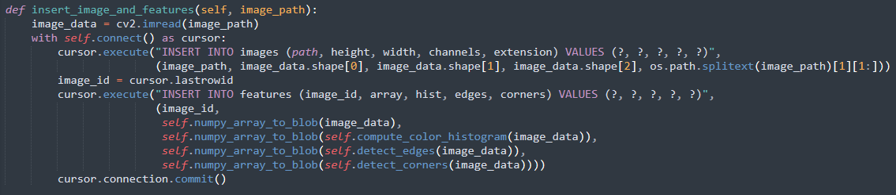
Technical Overview (1)
Data extraction: The initial step of the process, data extraction, is performed by a loader capable of reading a multitude of image formats. These include JPEG, PNG, TIFF, BMP, and more. This feat was achieved by integrating the capabilities of two existing libraries, PIL (Pillow), and OpenCV. Both individual images and directories comprising subdirectories of images can be navigated by the loader, which systematically traverses the file tree.
8

Slide 9
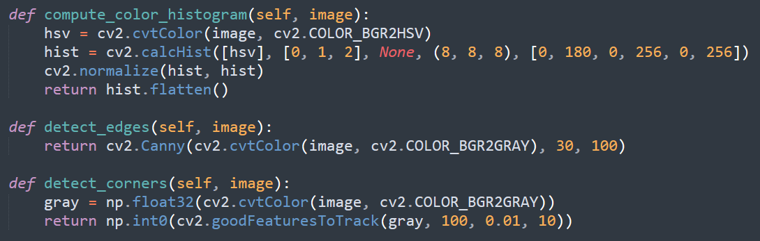
Technical Overview (2)
Feature extraction: After successful data extraction, the next stage involves the extraction of meaningful features. This task is performed by feature extractors equipped to handle basic and complex features. Simple features include color histograms, texture, and shape, while complex ones encompass edges and corners. Moreover, deep learning features derived from pre-trained models are incorporated. OpenCV is the primary tool utilized for simple feature extraction, but when paired with scikit-image, advanced features are effectively extracted.
9

Slide 10
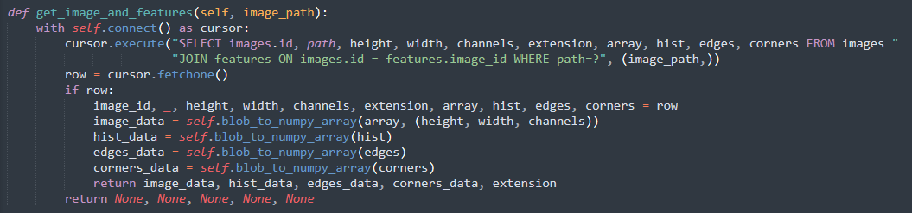
Technical Overview (3)
Data transformation: Subsequent to the extraction of features, they are converted into an SQL format, which enables query-ability. Libraries such as SQL3Lite and psycopg2 are utilized to create SQL tables and to insert data into them. This transformation allows the initially unstructured image data to be stored and queried in a structured manner, facilitating a more efficient data handling process.
10

Slide 11
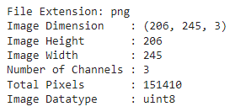
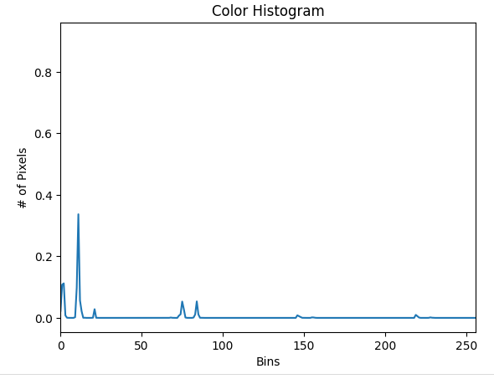

Results (Sample Image Output)
11

Slide 12
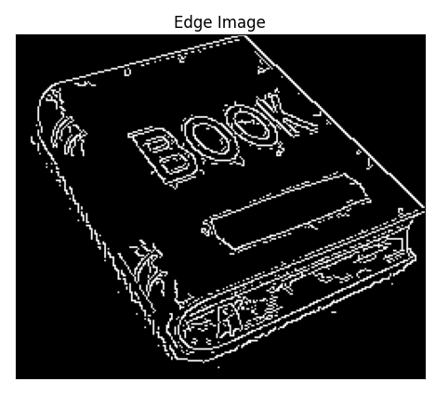
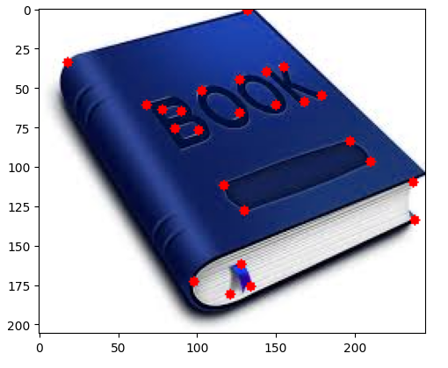
Edge Array Visualized:
Results (Sample Image Output)
BLOB storage is converted into Numpy arrays to facilitate visualzation with MatPlotLib
Corner Vector Visualized:
12

Slide 13
Future Work
Comprehensive comparative analysis with PyTorch DataLoader Class
Support for more dataset types (text, video, etc.)
Scope-Specific Image Format Support (medical imaging, satellite capture, etc.)
Metadata Extraction
NoSQL Implementation – Primarily, MongoDB
13

